Slide 1

TPS Reporting’s Weekly Report #7
Team Leader: Nicholas Alcorn
Other Members: Trevor Bal, Carl Moon II, Yasmina Rabhi, & Cameron Randolph

Slide 2
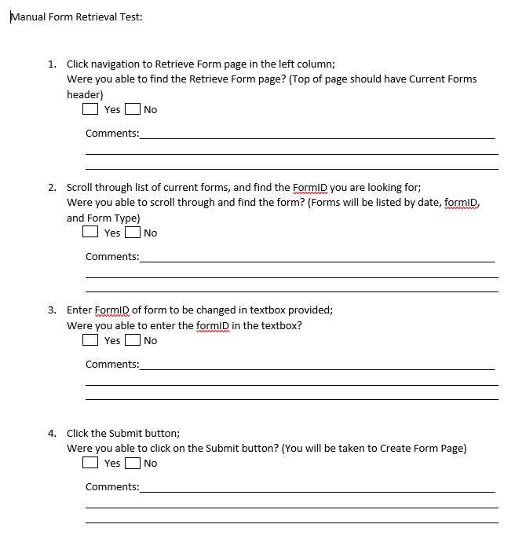
Tests

Slide 3
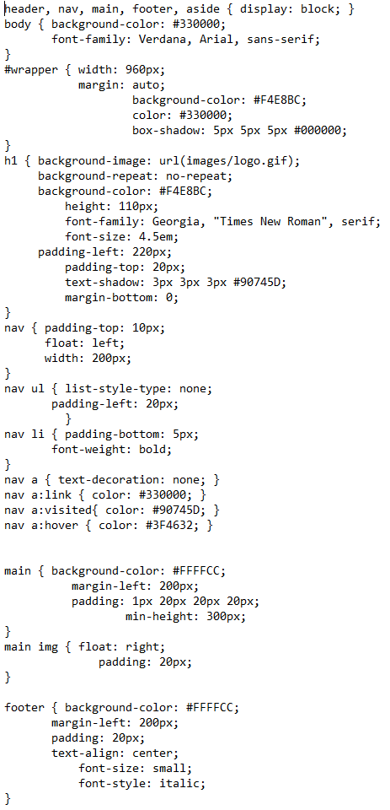
Running Code

Slide 4
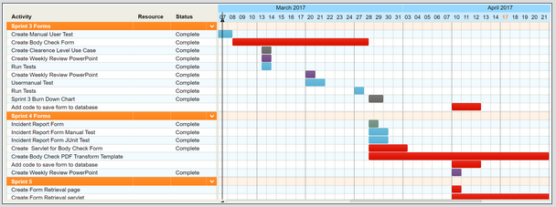

Project Plan

Slide 5
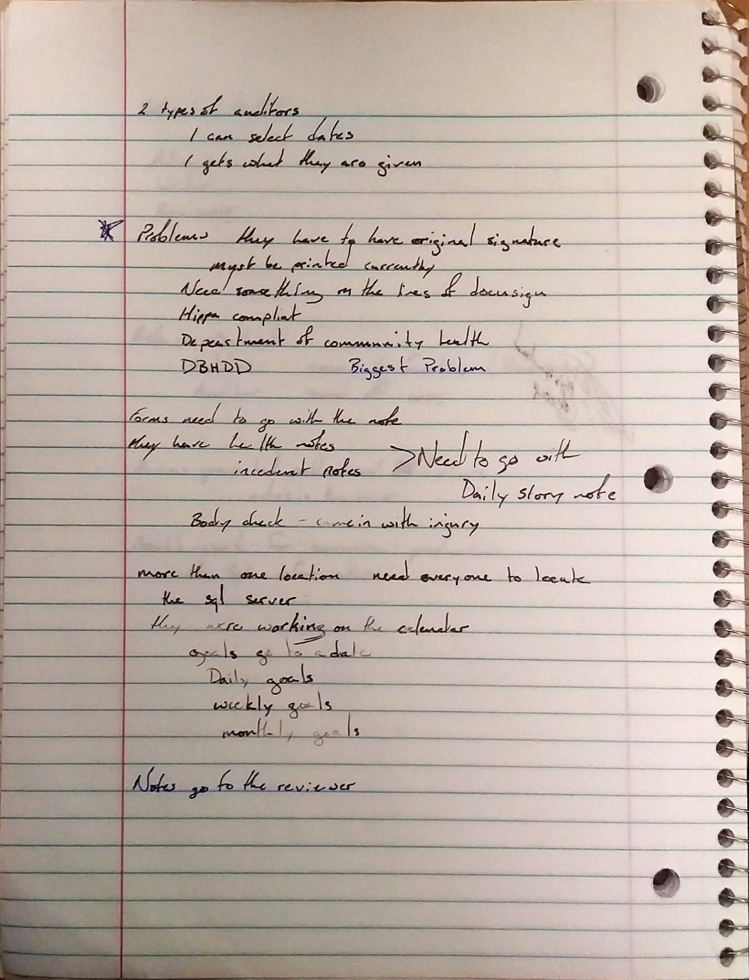
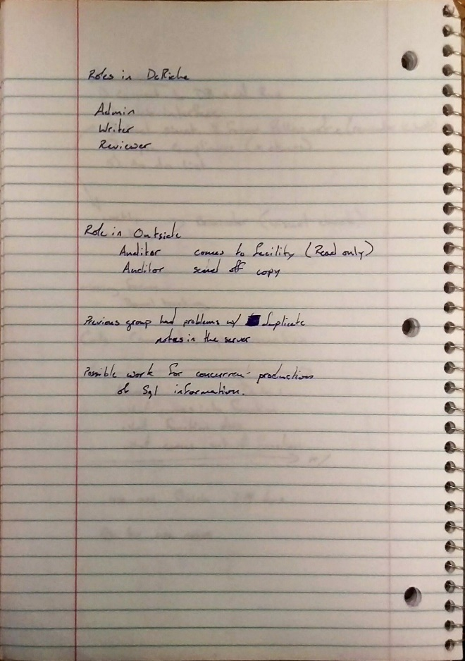
Deliverables

Slide 6
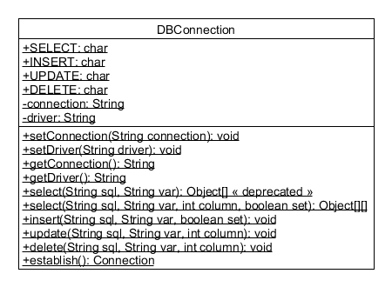
Deliverables (Continued)

Slide 7
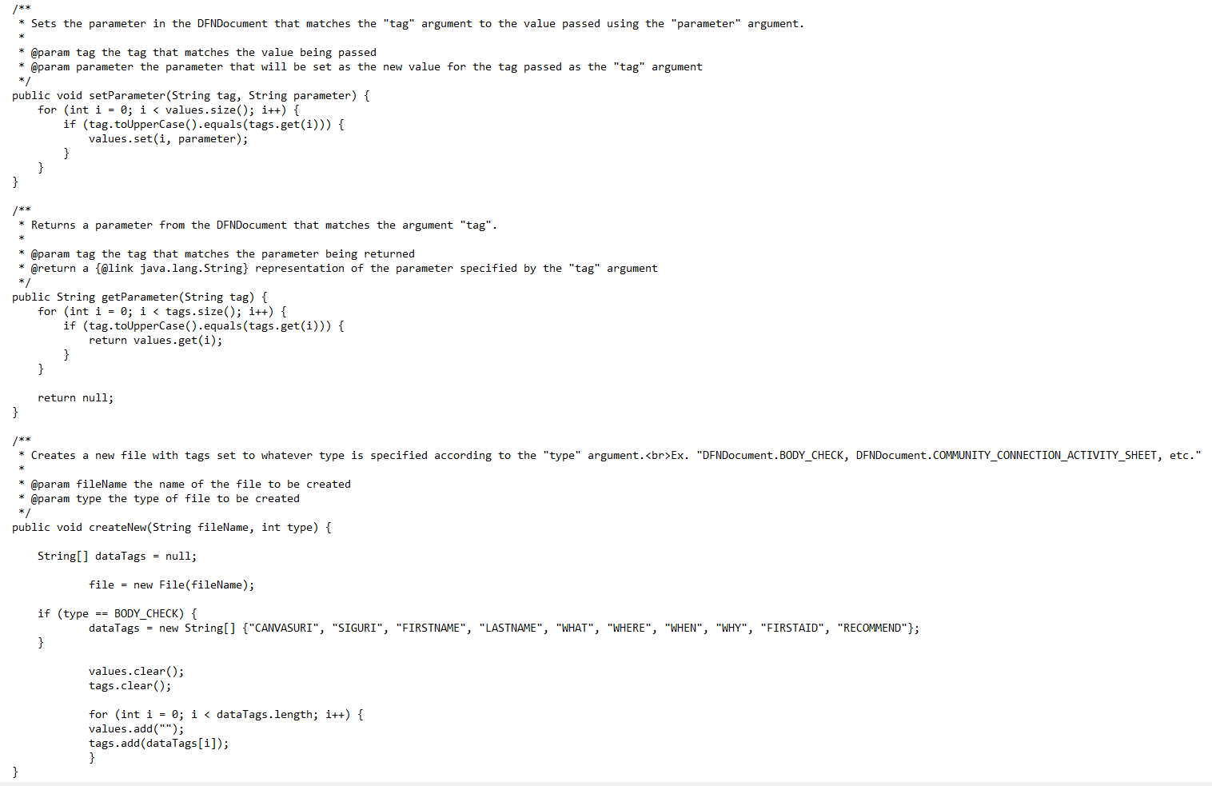
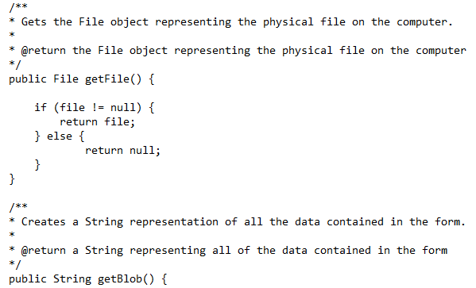
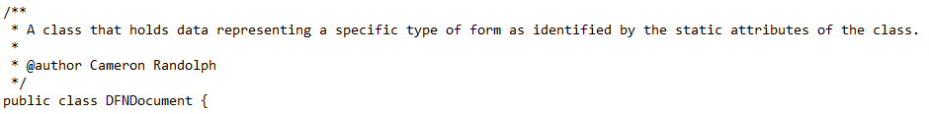
Deliverables (Documentation)

Slide 8
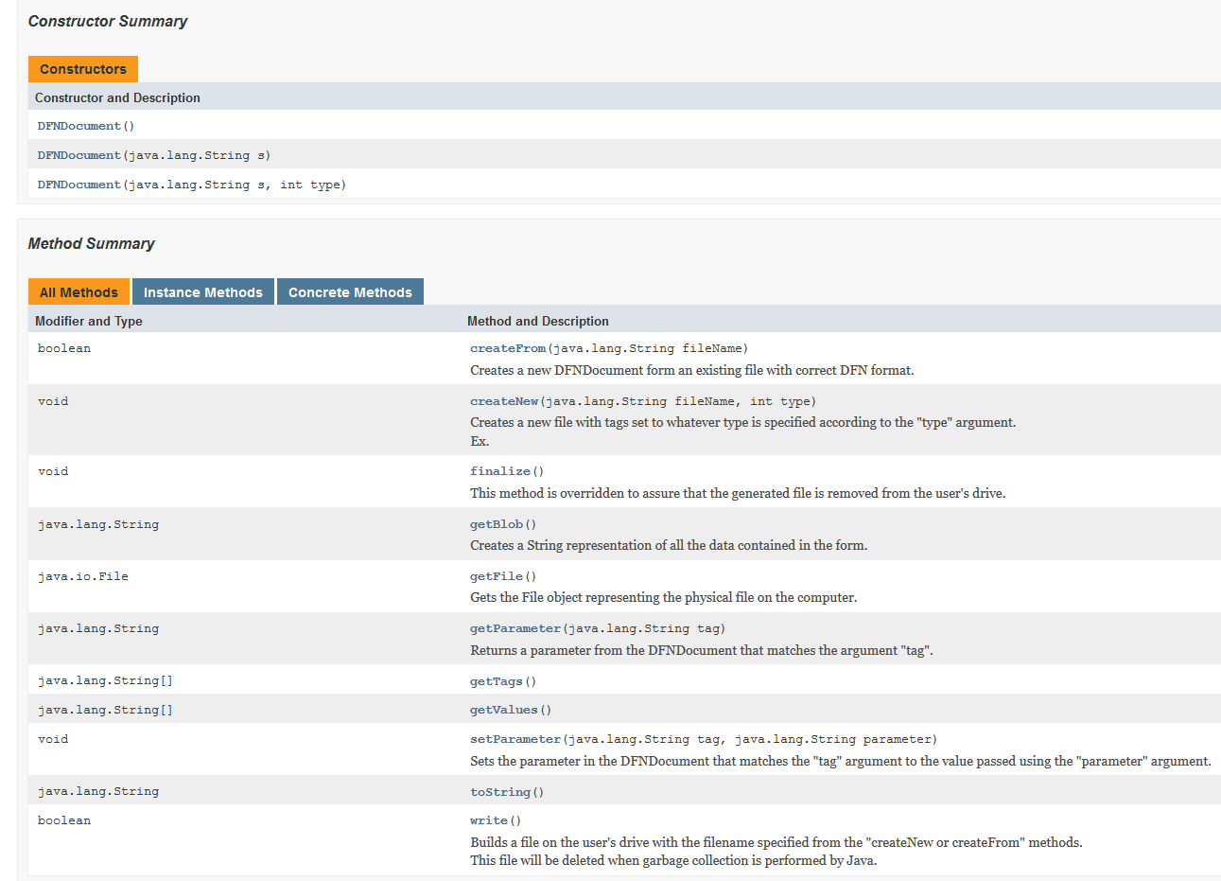
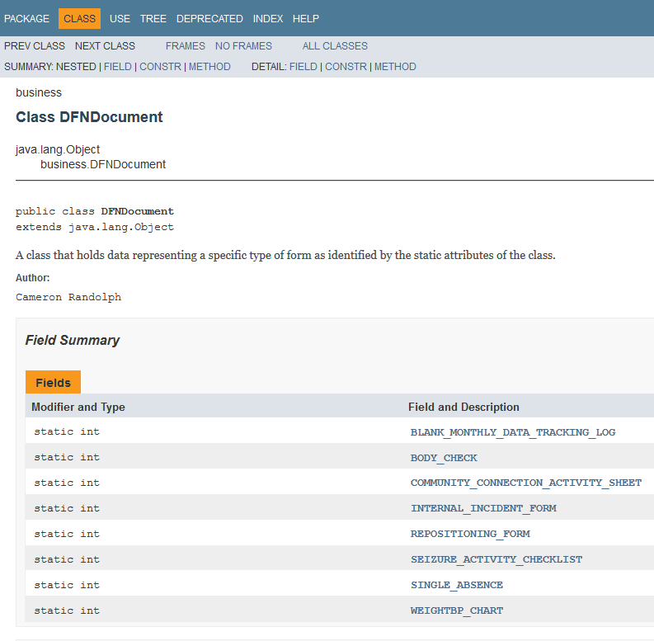
Deliverables (Documentation)

